Slide 1
Content creating Virtual Assistants at Contact center
Team Name
4AI Creation Bro’s

Slide 2

Problem Statement
The customer's aching point is that they have to wait for a long time to be answered and have to talk to an agent that is not consistent in solving their problems, thus they become not satisfied and loyal to the company anymore.
Stakeholders:
Customers,Contact Center Agents,Management.

Slide 3
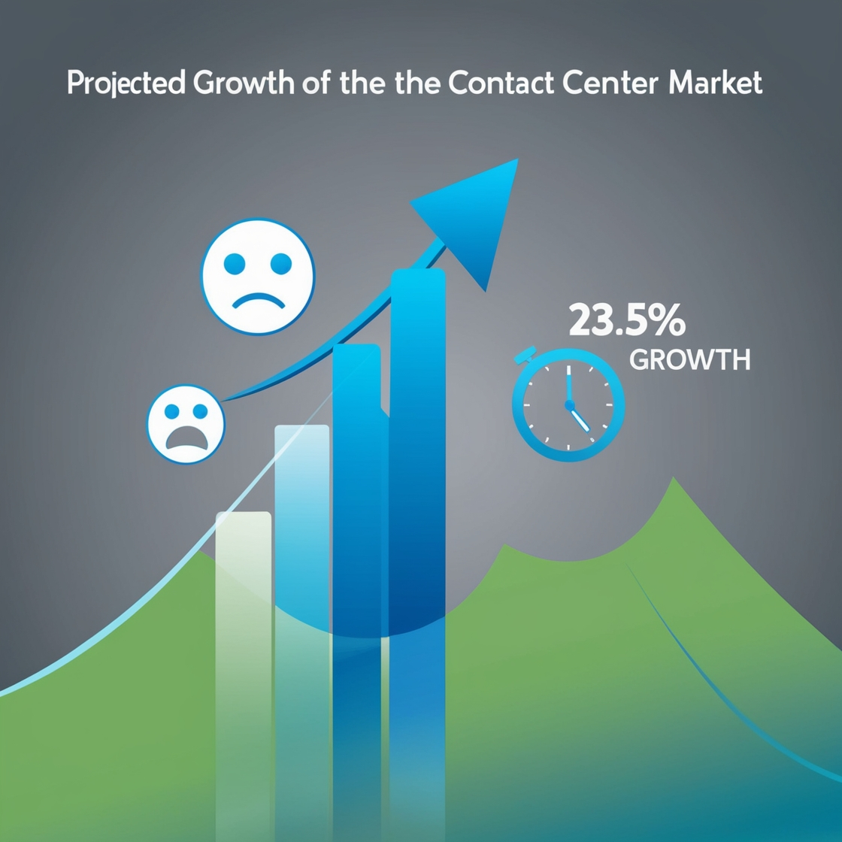
Market Size
The global contact center market is forecast to hit $496 billion by 2027, growing at a CAGR of 23.5%. (Source: Market Research Future)
More than 60% of customers complain of the long wait times." (Source: Zendesk)

Slide 4

Existing Solutions
Classic contact centers with less automation.
CRM systems that do not have any integration capabilities.
Competitors:
Companies like Salesforce, Zendesk, and Freshdesk dominate the space but still face challenges with automation and integration.
The shortlisted AI solutions are new comers such as Ada and Intercom.

Slide 5
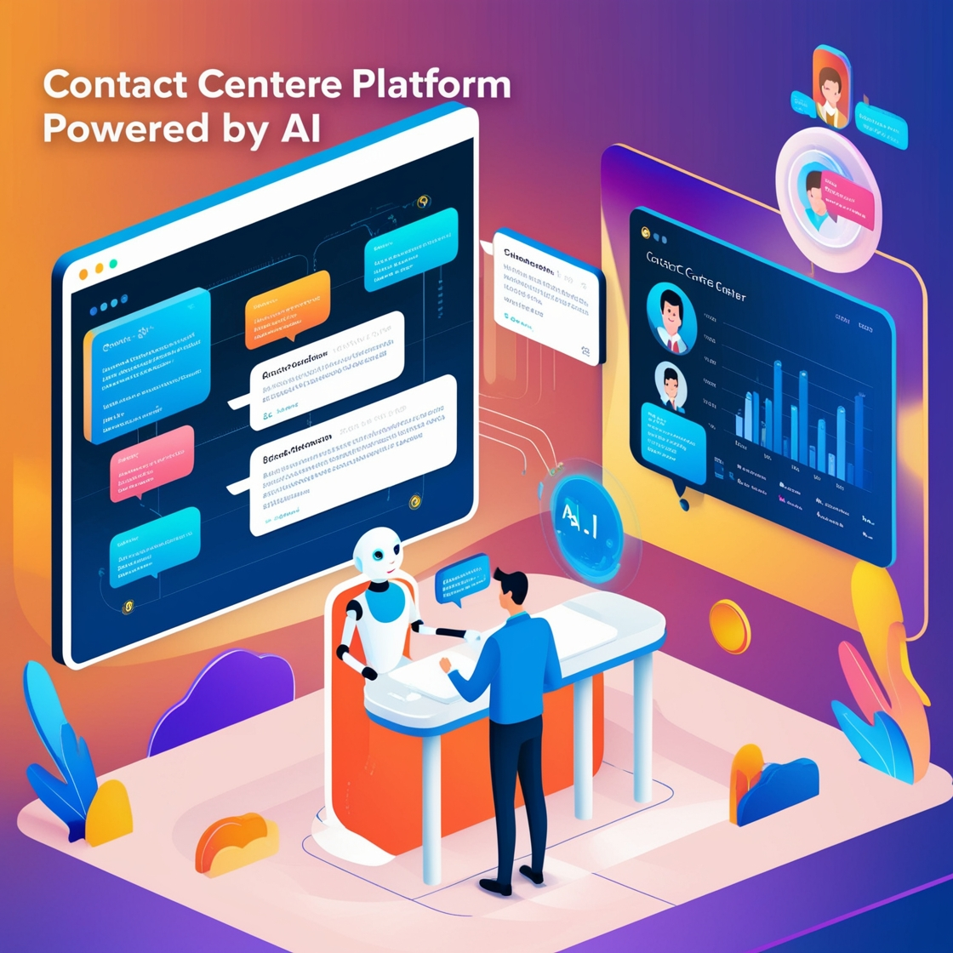
Solution Approach and USP
Solution:
An AI-powered contact center platform that integrates chatbots to handle routine queries, reducing wait times and boosting efficiency. The platform can process and respond in Telugu, enhancing accessibility for Telugu-speaking customers. Additionally, it offers real-time sentiment analysis to provide agents with insights for delivering personalized, empathetic service.
Unique Selling Proposition (USP):
Real-Time Sentiment Analysis
Multilingual Support
AI-Driven Analytics & Proactive Resolution

Slide 6
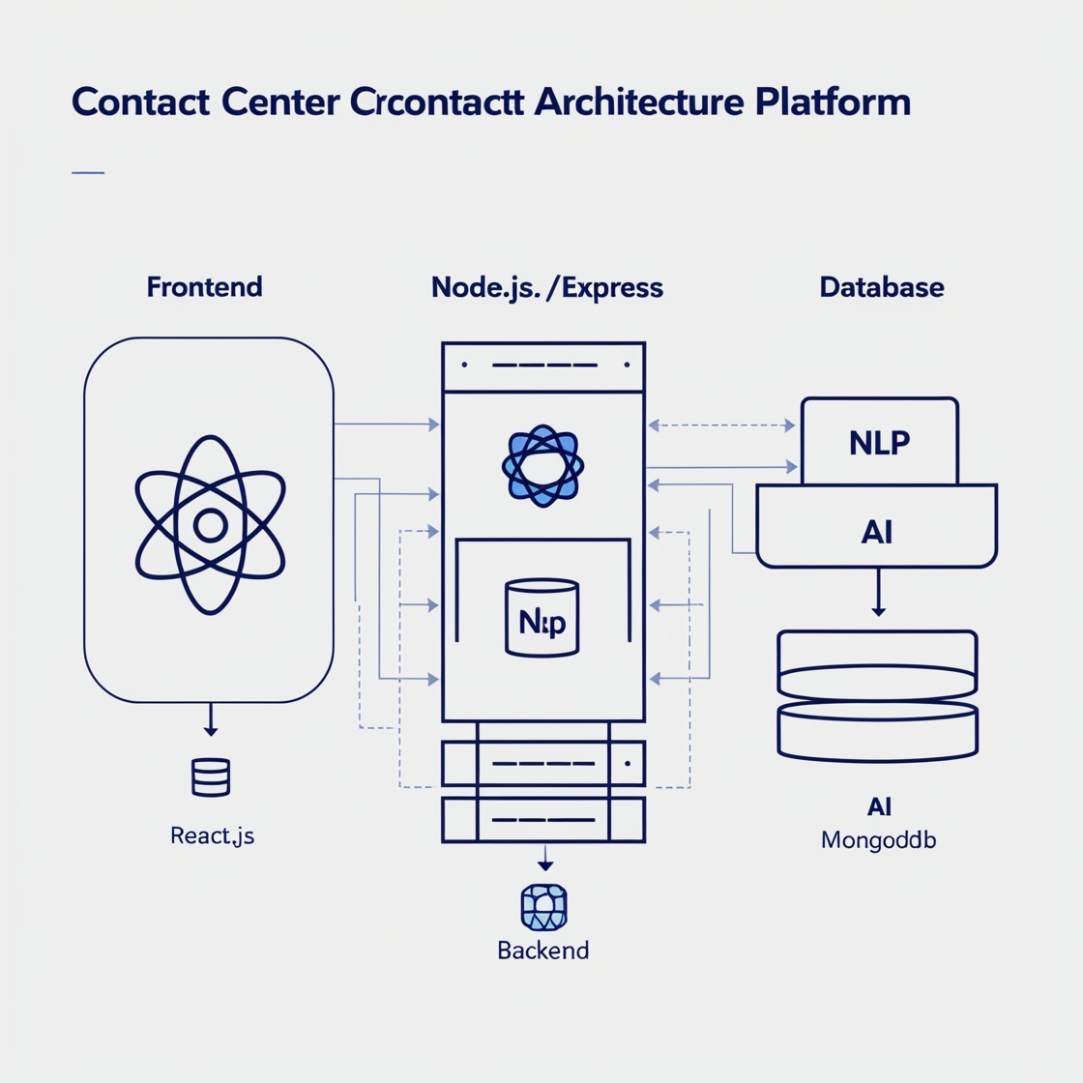
High-Level Technology Architecture
Frontend: React.js for user interface.
Backend: Node.js with Express for server-side logic.
Database: MongoDB for data storage.
AI Components: Natural Language Processing (NLP) for sentiment analysis.
Integration: APIs for CRM and communication platforms.

Slide 7
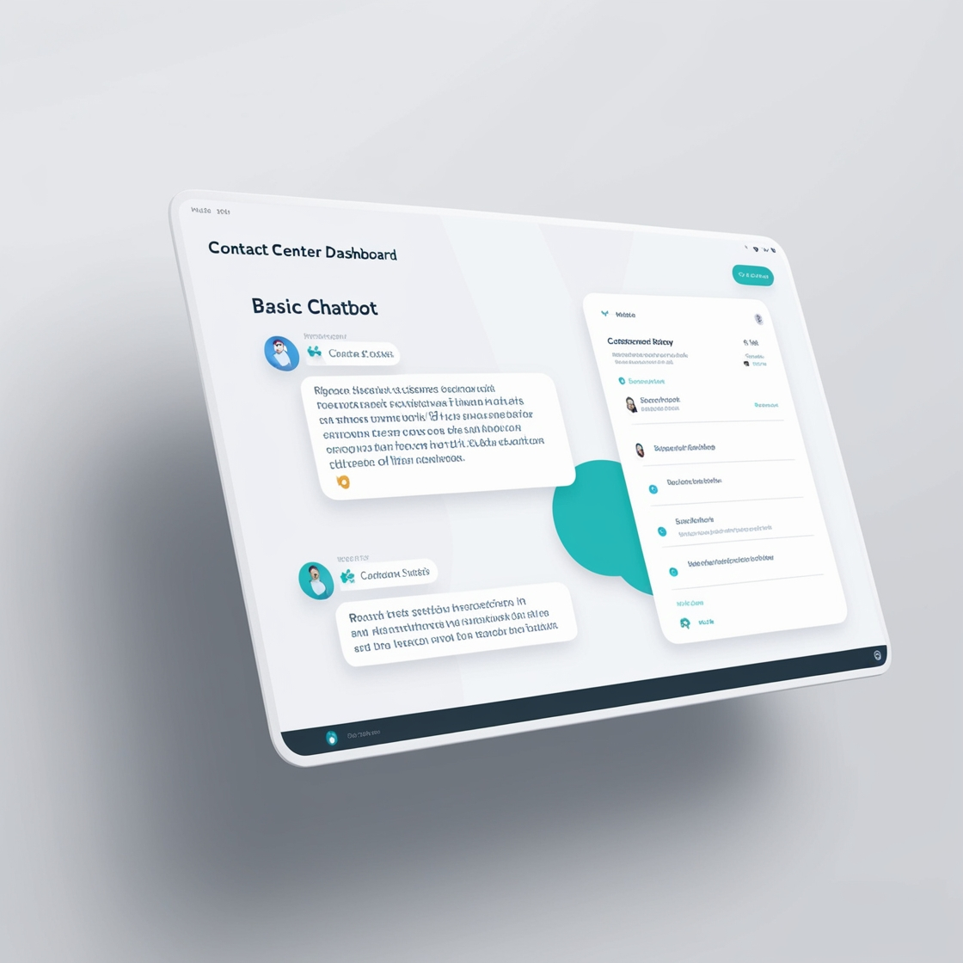
Feasibility and Prototype Development
Feasibility:
The proposed solution can be using existing frameworks and APIs.
Prototype Features:
Basic chatbot functionality for FAQs.
Dashboard for agents displaying customer sentiment and interaction history.

Slide 8

Conclusion and Call to Action
Summary:
Our solution addresses the core issues of long wait times and inconsistent service, leveraging AI to enhance customer satisfaction.
Next Steps:
We invite feedback and potential collaboration to refine and develop this solution further.

